Slide 1
AL 58 – Research Methodology and IPR
UNIT 5
Text Book: Dr. B L Wadehra,
Law Relating to Intellectual Property

Slide 2
Contents
Design: What is a Design? Essential Requirements for a Registrable Design, Procedure of Registration of a Design,
Trademarks: Essentials of a Trademark, Registration, and Protection of Trademarks, Rights Conferred by Registration of Trademarks, Infringements, Types of Reliefs, Case Studies.
Copyrights: Characteristics of Copyrights, Rights Conferred by Registration of Copyrights, Registration of Copyrights, Infringements, Remedies against Infringement of Copyrights, Case studies

Slide 3
What is a Design?
Design Act was enacted in the year 2000
“Design” means only the features of shape, configuration, pattern, ornament or composition of lines or colours applied to any article whether in two dimensional or three dimensional or in both forms, by any industrial process or means, whether manual, mechanical or chemical, separate or combined, which in the finished article appeal to and are judged solely by the eye; but does not include any mode or principle of construction or anything which is in substance a mere mechanical device, and does not include any trade mark

Slide 4
A design is defined under Section 2(d) of the Designs Act 2001,as only the features of a shape, pattern, configuration, composition, or ornament of lines or colors that are applied to any article that is two dimensional, three dimensional, or both by an industrial process or any means whether mechanical, manual or chemical, separated or combined, which in the finished article are judged solely by the eye; but is not taken into account upon the principle of construction or anything which is in substance a merely mechanical device.

Slide 5
Essential requirements for a registrable design
A design should be Original and new design. This means that it should not have been used or published previously in any country before the date of application of registration.
NO Prior publication (Publication in prior document & Publication by prior user)
The design must be applied to a particular article.
The design must have a visual appeal.
Effect of an earlier or later design

Slide 6
A design should be significantly distinguishable from known designs or a combination of known designs
A design should not comprise or contain scandalous or obscene matter
A design should not be a mere mechanical contrivance
A design should not be contrary to public order or morality

Slide 7
Procedure for registration of a design
The procedure consists of the following steps:
Submission of application
Documents to be filed with the application
Acceptance / Objections / Refusal
Removal of Objections / appeal to Central Government
Decision of Central Government
Registration of a Design

Slide 8
Filing of Application: The application for design registration must be made on Form-1 along with the prescribed fee. The application must include the name, address, and nationality of the applicant, name of the article, class number, and address for service in India. The application must be signed by the applicant or an authorized agent, who must be a registered patent agent or legal practitioner in India.
Examination: After filing the application, the design is examined to ensure that it meets the formal requirements. The examination includes a substantive examination to determine if the design is novel, original, and has not been published or used before.

Slide 9
Publication: If the design is found to be eligible for registration, it is published in the Patent Office Journal.
Opposition: After publication, any person can file an opposition to the registration of the design within four months from the date of publication.
Registration: If no opposition is filed, or if the opposition is unsuccessful, the design is registered and a certificate of registration is issued.

Slide 10


Slide 11


Slide 12
Trademark
The trademark act was enacted in the year 1999.
A trademark is a type of intellectual property consisting of a recognizable sign, design, or expression that identifies a product or service from a particular source and distinguishes it from others. A trademark owner can be an individual, business organization, or any legal entity. A trademark may be located on a package, a label, a voucher, or on the product itself. Trademarks used to identify services are sometimes called service marks.

Slide 13
Essentials of a Trademark
A trademark must be a mark which includes a device, heading, brand, label, ticket, signature, word, letter, name, numeral, packaging or combination of colors or any combination of the above attributes.
It should be easy to speak and spell. A good trademark is such that the public can easily spell and speak.
It should be easy to remember. A good trademark that is easy to speak and spell can be easily remembered as well. So that it becomes easy for public to
It should not be too lengthy and complicated to be forgotten easily. If it is lengthy or complicated, people will not bother to take the effort to memorize it and ultimately it will be forgotten.

Slide 14
It must be distinctive. It can be natural distinctiveness or acquired distinctiveness.
The best trademarks are invented words or coined words or unique geometrical designs
It can only be suggestive of the quality of the products, but not descriptive

Slide 15
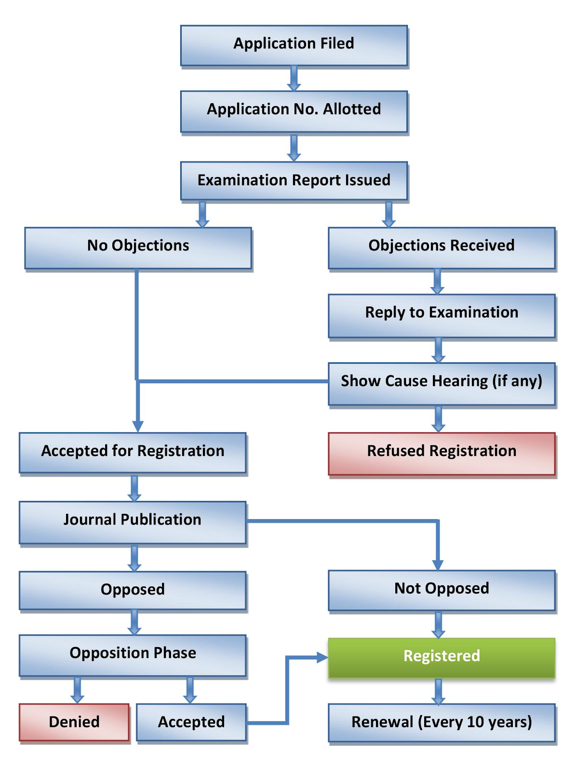
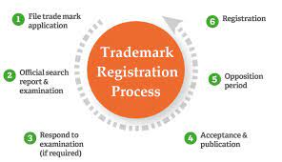
Registration of a Trademark

Slide 16
Protection of Trademarks in India
To protect the trademark in India, the following remedies can be resorted.
Civil Remedies
Criminal Proceedings
Administrative Remedies

Slide 17
Criminal Remedies:
When instances of infringement and passing off occur, the court of competent jurisdiction (not lower than district court) can be moved for grant of interlocutory injunction, Anton pillar orders, damages and account of profits.

Slide 18
Criminal Proceedings:
Complaint may be made against person causing infringement.
Both the actions under civil law and criminal law can be initiated simultaneously. Under the civil law proceedings, the plaintiff seeks reliefs for himself while under the criminal law proceedings the complainant seeks award of punishment to the infringer.

Slide 19
Administrative Remedies:
Opposition the registration of deceptively similar trade mark when the Trade Mark registry is in the process of considering the grant of a trade mark, can protect the trademark. The registry can also be moved for removal of a deceptively similar trade mark.

Slide 20
Rights conferred by registration of Trademarks
Section 28 of the Trademark Act 1999 confers on the proprietor of the trademark, exclusive right to use of trade mark in relation to the goods or services in respect of which the trade mark is obtained. In addition to conferring the right of exclusive dealing, the proprietor of the trademark also has the right to file a suit for infringement of his right and obtain:Temporary injunction.
Permanent injunction.
Damages.
Account of profits (damages in the amount of the profits gained from the infringement)
Destruction of goods using the infringing mark.
Cost of legal proceedings

Slide 21
Infringements
A trademark is said to be infringed, when a registered trademark or a trademark deceptively similar to the registered trademark is used by a person, who is neither the registered proprietor nor the licensee and/or assignee of the said trademark in relation to the goods and services for which it is registered.

Slide 22
A registered trademark is said to be infringed in case of the following situation:
If the mark in dispute is identical with or deceptively similar to the registered trademark and is in relation to the same or similar goods or services;
If the identical or similar mark can cause confusion in the minds of general public to have an association with the registered trademark
If the registered trademark is used as a part of trade name or business concern for goods and services in respect of which the trademark is registered
If the trademark is advertised and as a result it takes unfair advantage or is contrary to the honest practices or is detrimental to the distinctive character and reputation of the registered trademark.
If the registered trademark is used in the material meant for packaging or labelling of other goods or as a business paper without due authorization of the registered user.

Slide 23
Types of reliefs to which a plaintiff is entitled are:
An injunction restraining further use of the infringement mark.
Anton Piller Injunction
Mareva Injunction
Interlocutory injunction
Perpetual Injunction
Damages or an account of profits
An order to delivery up infringing labels and marks for destrucrion or erasure.

Slide 24
Copyrights
Copyright (or author's right) is a legal term used to describe the rights that creators have over their literary and artistic works. Works covered by copyright range from books, music, paintings, sculpture, and films, to computer programs, databases, advertisements, maps, and technical drawings.
Copyright is a type of intellectual property that protects original works of authorship as soon as an author fixes the work in a tangible form of expression.

Slide 25
Characteristics of copyrights
Creation of a Statute
Some form of Intellectual Property
Monopoly Right
Negative Right
Multiple Right
Copyright only in the form of an Idea
Neighboring Rights

Slide 26
Rights conferred by registration of Copyrights.
Statutory Rights
Negative Rights
Multiple Rights
Economic Rights
Moral Rights

Slide 27
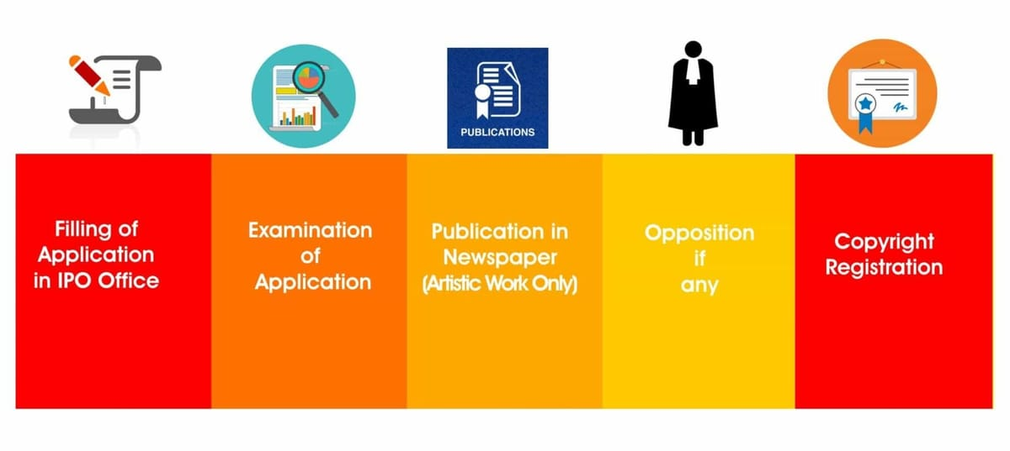
Registration of Copyrights.

Slide 28
Infringements
Copyright infringement is the use or production of copyright-protected material without the permission of the copyright holder. Copyright infringement means that the rights afforded to the copyright holder, such as the exclusive use of a work for a set period of time, are being breached by a third party. Music and movies are two of the most well-known forms of entertainment that suffer from significant amounts of copyright infringement. Infringement cases may lead to contingent liabilities, which are amounts set aside in case of a possible lawsuit.

Slide 29
Copyright infringement is the use or production of copyright-protected material without the permission of the copyright holder.
Individuals and companies who develop new works register for copyright protection to ensure that they can profit from their efforts.
Other parties may be granted permission to use those works through licensing arrangements or buy the works from the copyright holder.

Slide 30
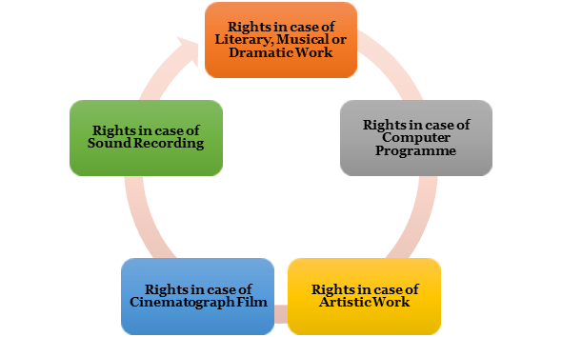
Infringements Types

Slide 31
Remedies against Infringement of copyrights
Civil Remedies
Anton Piller
Interlocutorty Injunction
Damages or Account of Profits
Criminal Remedies
Administrative Remedies

Slide 32


